Slide 1

INTRODUCTION TO CHEMISTRY
CML-101
Tutorial 1
Dr. Chinmoy K. Hazra
Department of Chemistry
IIT Delhi
12-12-2020

Slide 2
Structural Isomers
Ans 1:

Slide 3
Ans 2: R/S nomenclature

Slide 4
Ans 3: R/S nomenclature

Slide 5
Ans 4: Fischer Projection into Sawhorse Projection

Slide 6
Ans 5: Sawhorse projection into Fischer projection:

Slide 7
Ans 6: Newman to Sawhorse projection

Slide 8
Ans 7: Sawhorse to Newman and Flying Wedge Projection

Slide 9
Ans 8: Meso-2,3-dibromobutane contains two chirac centres (marked with *) but it does not exhibit any optical activity due to internal compensation and hence is optically inactive.

Slide 10
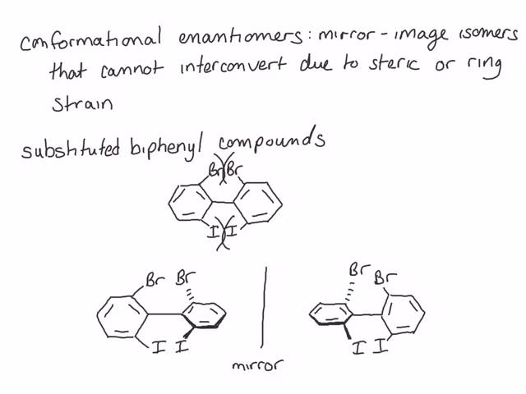
Ans 9: These molecules show chirality and hence they are enantiomers. Examples of such compounds are o-substitued biphenyls and allenes having even number of double bonds.
Non superimposable mirror images hence enantiomeric and optically active

Slide 11
Ans 9: Allenes: Due to sp hybridization of central carbon which forms two p-bonds perpendicular to each other and thus the two groups attached to terminal carbon atoms are also orthogonal. Due to this arrangement the molecule of allene is devoid of symmetry and hence is chiral.
Therefore, necessary and sufficient condition for compounds to exhibit enantiomerism is that they should possesses chirality or dissymmetry rather than asymmetry.

Slide 12
Ans 10: Butan -1,2,3-triol (CH₃*CHOH-*CHOH-CH₂OH) has two dissimilar chiral carbon atoms.Here n = 2
Now, Number of optical isomers = 2² = 4
Number of meso forms = 0
Total number of stereoisomers = 4 + 0 = 4

Slide 13
Ans 11: Trihydroxyglutaric acid, (HOOC— *CHOH —*CHOH—*CHOH—COOH), has three chiral carbon atoms.i.e. n =3. No. of optical isomers=2³⁻¹ - 2^{(3-1)/2}=2² - 2¹ =4-2 = 2, No. of meso-forms =2^{(3-1)/2} =2¹ = 2, So total no. of stereoisomers =2+2 = 4(or 2³⁻¹=2²=4)

Slide 14
Q12: How many stereo isomers you can get from the following two reaction?

Slide 15
Ans 13: Since it is levorotatory, this must be (-)-butan-2-ol. The concentration is 6.0 g per 40.0 mL = 0.15 g/mL, and the path length is 200 mm = 2.00 dm. The specific rotation is (-) 13.5 degree

Slide 16
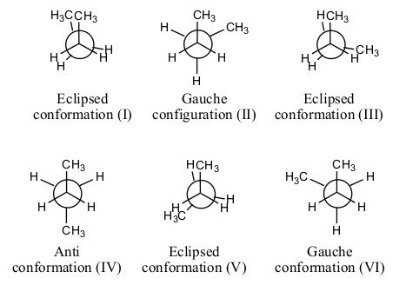
Ans 14: Newman Projection: eclipsed = least stable conformations and straggered = most stable conformations

Slide 17
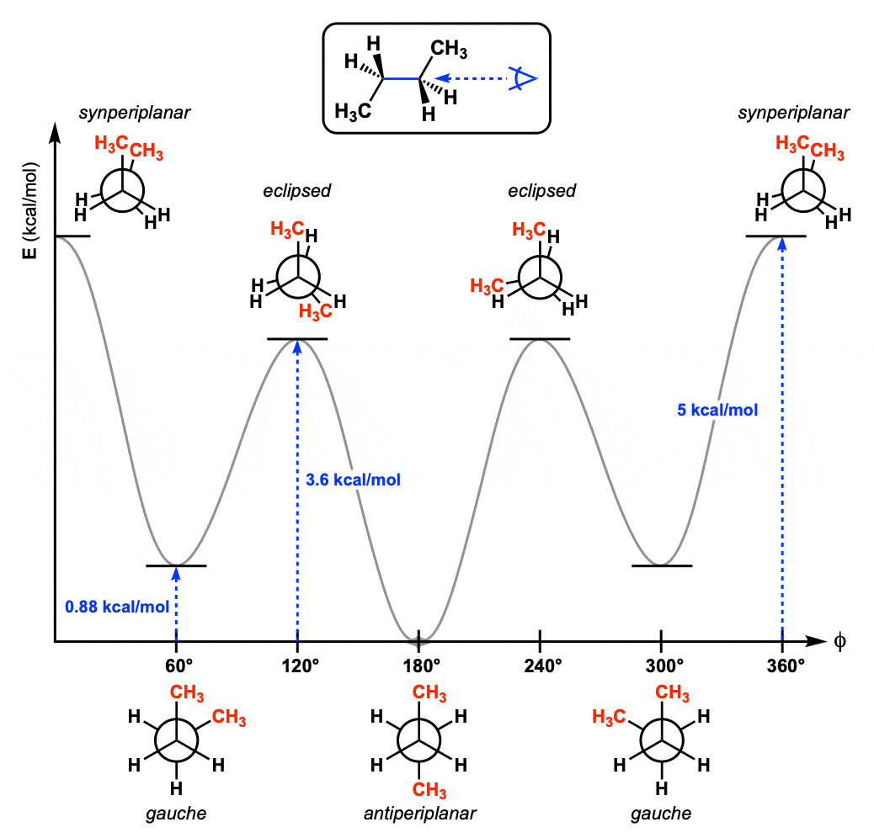
Ans 14: Newman Projection: eclipsed = least stable conformations and straggered = most stable conformations

Slide 18
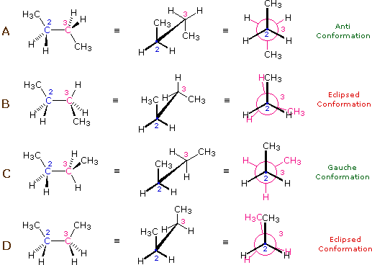
Ans 14: Sawhorse Projection: eclipsed = least stable conformations and straggered = most stable conformations

